Slide 1

Software
Upgrade
&
Licence
Milpo
Online
Takeaway
NetShop
Remote
Support
Logon to
SuperPOS
SuperPOS ePOS System Version 3.01 Copyright @ 2014 All Right Reserved Gwenwich (UK) Limited

Slide 2


Password
Date: 02/10/2012
Time: 11:05:38
A
1
2
3
Session: LUNCH
B
4
5
6
C
7
8
9
LOGON
EXIT
D
CLEAR
0
OK

Slide 3
08/12/2014
Desktop Area
18:35:36
DINNER
STAFF8
Takeaway
Cash
Drawer
Eat In
Show
Order
Control
Panel
Quick Food
Logout

Slide 4
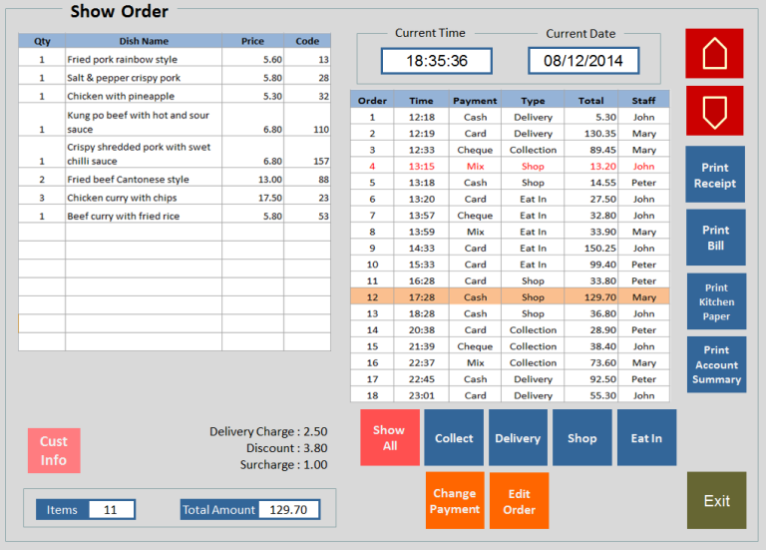
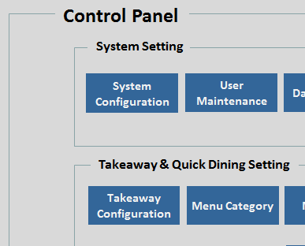
Desktop Area
Takeaway
  Goes to Takeaway application
Eat In
  Goes to restaurant Eat In application
Quick Food
  Goes to quick food mode
Cash Drawer
  Open cash drawer (may require password for ordinary staff)
Show Order
  Goes to Show Order screen
Control Panel
  Goes to Control Panel screen
Logout
  Returns to user Log on screen

Slide 5
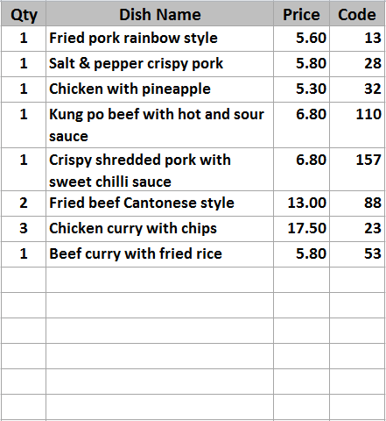
Delivery
2
Shop
Mixed hot platter
Mixed hot platter
Mixed hot platter
Mixed hot platter
Duck spring rolls
Duck spring rolls
Duck spring rolls
Duck spring rolls
Beef ginger and
spring onion
Beef ginger and
spring onion
Beef ginger and
spring onion
Beef ginger and
spring onion
Chicken yellow bean
cashew nuts
Chicken yellow bean
cashew nuts
Chicken yellow bean
cashew nuts
Chicken yellow bean
cashew nuts
MENU 1
Roast
Pork
Roast
Pork
Roast
Pork
Roast
Pork
Roast
Pork
SEARCH
MEAL
Szechuan
Szechuan
Szechuan
Szechuan
Szechuan
LANGUAGE
BBQ
Sauce
BBQ
Sauce
BBQ
Sauce
BBQ
Sauce
BBQ
Sauce
CHANGE
ORDER TYPE
Tomato
Tomato
Tomato
Tomato
Tomato
11
£67.95
18:48:30
86
Remove
Item
KEYPAD
Foo
Yung
Foo
Yung
Foo
Yung
Foo
Yung
Foo
Yung
+
-
Cust
Info
CID
+ / -
PAY
CANCEL
ORDER
Tray Meal
Tray Meal
Tray Meal
Tray Meal
Tray Meal
Desktop
Pending
Orders
Tray Meal
Tray Meal
Tray Meal
Tray Meal
Tray Meal

Slide 6




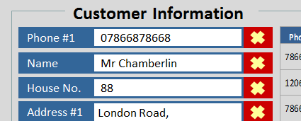
Takeaway Order Taking Screen
Delivery 2 3
  Delivery is the current order being handled. If you press 2, the Delivery will be put on hold and 2 is the order being processed. Order on Hold is RED
Information Display
  11 is the item total, £67.95 is total order amount, 18:48 is the current time. 86 is the dish code being keyed in by the key pad (either on screen or keyboard)
Function Keys
  Upper and low arrow, scroll order up and down. + or - to increase or decrease quantity by 1. Remove is to remove the food item completely
Customer Information
  Goes to Customer Information screen

Slide 7
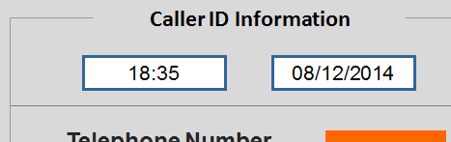
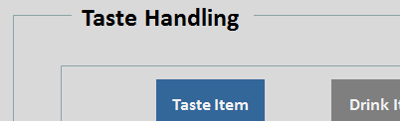
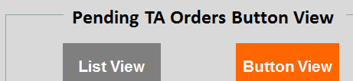

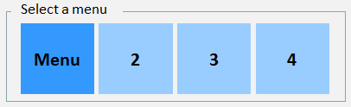
Takeaway Order Taking Screen
CID
  Display the Caller ID information screen
+ / -
  Goes to Taste Handling screen
Desktop
  Goes to Desktop screen and if there is an order being processed, the order will be put on hold
Pending
Orders
  Goes to Pending TA Orders screen. There is a setting that define the default view when the button is pressed
PAY
  Goes to Check Out screen
  Goes Previous or Next page of food items
MENU 1
  Select one of the 4 menus

Slide 8
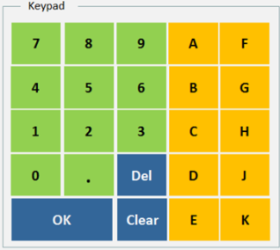
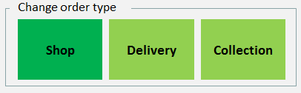
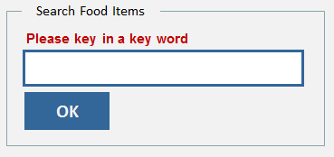

Takeaway Order Taking Screen
  Goes Previous or Next page of Categories
CANCEL
ORDER
  Cancel the whole order. Display Are you sure to cancel the order?
KEYPAD
  When press will pop up the on screen Keypad
CHANGE
ORDER TYPE
  Change order type among Shop, Delivery or Collection
  Will show whether the order is shop, delivery or collection
LANGUAGE
  Whole screen switch between English and Chinese
SEARCH
MEAL
  Search the name of a dish and display result on the food item display area

Slide 9
08/12/2014
Takeaway
Eat - In
Quick Food
18:35:36
DINNER
1
2
3
4
5
6
7
8
9
10
STAFF8
11
12
13
14
15
16
17
18
19
20
21
22
23
24
25
26
27
28
29
30
Cash
Drawer
31
32
33
34
35
36
37
38
39
40
Show
Order
-
-
-
-
-
-
-
-
-
-
-
-
-
-
-
-
-
-
-
-
Control
Panel
-
-
-
-
-
-
-
-
-
-
-
-
-
-
-
-
-
-
-
-
Logout
Billed & Unpaid
Being Processed
Not Used

Slide 10
Quick Food Table Layout Screen
  These are reference number (or actual table number for some users)
3
  When this button is pressed, it ask for the reference number you want to assign. E.g. 888, AAB…
-

Slide 11
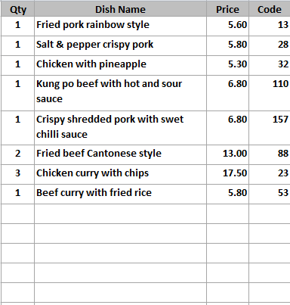
Ref: 2
Mixed hot platter
Mixed hot platter
Mixed hot platter
Mixed hot platter
Duck spring rolls
Duck spring rolls
Duck spring rolls
Duck spring rolls
Beef ginger and
spring onion
Beef ginger and
spring onion
Beef ginger and
spring onion
Beef ginger and
spring onion
Chicken yellow bean
cashew nuts
Chicken yellow bean
cashew nuts
Chicken yellow bean
cashew nuts
Chicken yellow bean
cashew nuts
MENU 1
Roast
Pork
Roast
Pork
Roast
Pork
Roast
Pork
Roast
Pork
SEARCH
MEAL
Szechuan
Szechuan
Szechuan
Szechuan
Szechuan
LANGUAGE
BBQ
Sauce
BBQ
Sauce
BBQ
Sauce
BBQ
Sauce
BBQ
Sauce
11
£67.95
18:48:30
86
+
Remove
Item
CHANGE
REF
NUMBER
Tomato
Tomato
Tomato
Tomato
Tomato
-
KEYPAD
Foo
Yung
Foo
Yung
Foo
Yung
Foo
Yung
Foo
Yung
+ / -
PAY
CANCEL
ORDER
Tray Meal
Tray Meal
Tray Meal
Tray Meal
Tray Meal
Desktop
Tray Meal
Tray Meal
Tray Meal
Tray Meal
Tray Meal

Slide 12
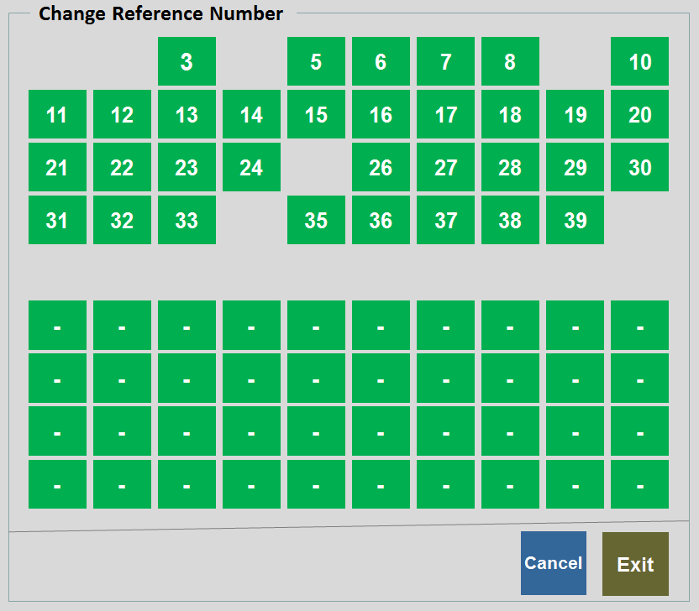
Quick Food Order Taking Screen
  Change Reference Number 2 to any available numbers
CHANGE
REF
NUMBER

Slide 13
08/12/2014
Takeaway
Eat - In
Quick Food
18:35:36
DINNER
1
2
3
4
5
6
7
8
9
10
STAFF8
11
12
13
14
15
16
17
18
19
20
Table
Status
21
22
23
24
25
26
27
28
29
30
31
32
33
34
35
36
37
38
39
40
Table
Booking
Show
Order
-
-
-
-
-
-
-
-
-
-
-
-
-
-
-
-
-
-
-
-
Control
Panel
-
-
-
-
-
-
-
-
-
-
-
-
-
-
-
-
-
-
-
-
Logout
RESERVED
Eating
Billed & Unpaid
Being Processed
Paid & Eating
Empty
VIP

Slide 14

Eat In Table Layout Screen
  Table marked with black frame is VIP which require special attention. If this button is double clicked, it goes to Customer Information page
25
  When this table order is being processed, user press Desktop to exit the page, this button will become navy blue (order content on hold), meaning the order is not printed, need to press Accept to print the order. After printing the order, colour becomes red
27

Slide 15
3
Table 2
Mixed hot platter
Mixed hot platter
Mixed hot platter
Mixed hot platter
Duck spring rolls
Duck spring rolls
Duck spring rolls
Duck spring rolls
Beef ginger and
spring onion
Beef ginger and
spring onion
Beef ginger and
spring onion
Beef ginger and
spring onion
Chicken yellow bean
cashew nuts
Chicken yellow bean
cashew nuts
Chicken yellow bean
cashew nuts
Chicken yellow bean
cashew nuts
MENU 1
Roast
Pork
Roast
Pork
Roast
Pork
Roast
Pork
Roast
Pork
SEARCH
MEAL
Szechuan
Szechuan
Szechuan
Szechuan
Szechuan
LANGUAGE
BBQ
Sauce
BBQ
Sauce
BBQ
Sauce
BBQ
Sauce
BBQ
Sauce
11
£67.95
18:48:30
86
+
-
REMOVE
ITEM
123
COURSE
Tomato
Tomato
Tomato
Tomato
Tomato
ORDER
CONTROL
FOOD
REMARK
+ / -
COURSE
DIVIDER
KEYPAD
Foo
Yung
Foo
Yung
Foo
Yung
Foo
Yung
Foo
Yung
PRINT
ORDER
TABLE FOOD
CHANGE
PAYMENT
CANCEL
ORDER
Tray Meal
Tray Meal
Tray Meal
Tray Meal
Tray Meal
Desktop
Logout
ACCEPT
Tray Meal
Tray Meal
Tray Meal
Tray Meal
Tray Meal

Slide 16
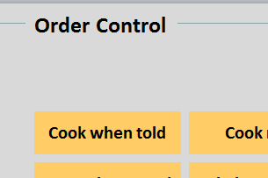
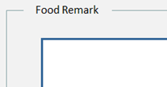

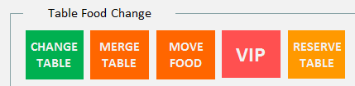
Eat In Order Input Screen
  It tells the cook how to handle this dish. E.g. as takeaway, on hold until notice 等叫才上…. Normally does not require additional charge
ORDER
CONTROL
  Similar to Order Control but user can type anything he wants
FOOD
REMARK
PRINT
ORDER
  上菜紙 print a copy all items that this table has order so far
COURSE
DIVIDER
  A line to separate the courses
TABLE FOOD
CHANGE
  Give the user more options when pressed
PAYMENT
  Goes to Check out screen

Slide 17
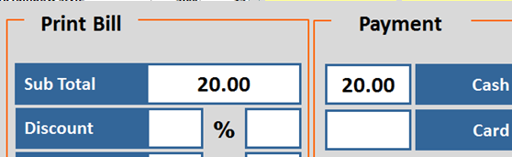
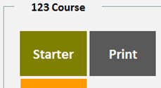

Eat In Order Input Screen
PAYMENT
  Goes to Check out screen
123
COURSE
  Tells the kitchen to start cooking the course 走二盘， 走正… Kitchen will get a print out if Print is pressed.
  The table status will change colour. The timer will start ticking
ACCEPT
  After taking order for this table, press Accept to print order details to all departments.
  User can press Desktop after taking order, but no printout and button change to navy blue

Slide 18
Control Panel
System Setting
System
Configuration
User
Maintenance
Data Manager
Compact
Database
Computer
Address
Shift Code
Takeaway & Quick Dining Setting
Takeaway
Configuration
Menu Category
Menu Item
Manage
Menu Set
Extra Menu
Edit
Order Control
Department
Code
Table Setup
Print Setup
Caller
Record
Eat In Setting
Eat-In
Configuration
Menu Category
Menu Item
Manage
Menu Set
Extra Menu
Edit
Order Control
Department
Code
Table Setup
Printer
Order Entry
Print Setup
Reporting
Account
Summary
Reports
System
Control
Exit

Slide 19
END
(Slides beyond this page are for references only)

